Slide 1
Android Application Development (I)
Practice – Testing

Slide 2
Agenda
Self Introduction
Intellectual Property Rights
Project Introduction
Android Introduction
Get Started with Android
Requirement
Object-Oriented Analysis and Design
Scrum
Coding
Acceptance Test Criteria
Publish Application
Notes:
Object-oriented analysis and design (OOAD) is a software engineering approach that models a system as a group of interacting objects. Each object represents some entity of interest in the system being modeled, and is characterised by its class, its state (data elements), and its behavior. Various models can be created to show the static structure, dynamic behavior, and run-time deployment of these collaborating objects. There are a number of different notations for representing these models, such as the Unified Modeling Language (UML).
Object-oriented analysis (OOA) applies object-modeling techniques to analyze the functional requirements for a system. Object-oriented design (OOD) elaborates the analysis models to produce implementation specifications. OOA focuses on what the system does, OOD on how the system does it.
Ref: http://en.wikipedia.org/wiki/Object-oriented_analysis_and_design
IFRS - International Financial Reporting Standards
GAAP - Generally Accepted Accounting Principles

Slide 3
Outline
Software Quality
Software Testing
Static Code Analysis
Findbugs
Stability
Monkey
References

Slide 4
What is Software Quality?
Software functional quality reflects how well it complies with or conforms to a given design, based on functional requirements or specifications. That attribute can also be described as the fitness for purpose of a piece of software or how it compares to competitors in the marketplace as a worthwhile product;
Software structural quality refers to how it meets non-functional requirements that support the delivery of the functional requirements, such as robustness or maintainability, the degree to which the software was produced correctly.

Slide 5
ISO 9126
Functionality - A set of attributes that bear on the existence of a set of functions and their specified properties. The functions are those that satisfy stated or implied needs.
Suitability
Accuracy
Interoperability
Security
Functionality Compliance
Reliability - A set of attributes that bear on the capability of software to maintain its level of performance under stated conditions for a stated period of time.
Maturity
Fault Tolerance
Recoverability
Reliability Compliance
Usability - A set of attributes that bear on the effort needed for use, and on the individual assessment of such use, by a stated or implied set of users.
Understandability
Learnability
Operability
Attractiveness
Usability Compliance

Slide 6
ISO 9126 – cont.
Efficiency - A set of attributes that bear on the relationship between the level of performance of the software and the amount of resources used, under stated conditions.
Time Behaviour
Resource Utilisation
Efficiency Compliance
Maintainability - A set of attributes that bear on the effort needed to make specified modifications.
Analyzability
Changeability
Stability
Testability
Maintainability Compliance
Portability - A set of attributes that bear on the ability of software to be transferred from one environment to another.
Adaptability
Installability
Co-Existence
Replaceability
Portability Compliance

Slide 7
Software Testing
Static vs. Dynamic Testing
Black-box vs. White-box Testing
Static-Black
Static-White
Dynamic Black
Dynamic White
Validation vs. Verification
Verification: Have we built the software right? (i.e., does it match the specification).
Validation: Have we built the right software? (i.e., is this what the customer wants).
Software Quality Assurance
Quality management
Quality goal and standard
Quality control
Software testing

Slide 8
Software Testing
Test targets
Unit testing
Integration testing
System testing
System integration
Objectives of testing
Regression testing
Acceptance Testing
Alpha & Beta testing
Non-functional testing
Software performance testing
Usability testing
Security testing
Internationalization and localization
Destructive testing

Slide 9
Findbugs
What does Findbugs do?
A static analysis tool
Identify potential types of errors in Java programsSystem testing
Operates on Java bytecode
What kinds of errors can be detected by Findbugs?
http://findbugs.sourceforge.net/bugDescriptions.html
Bug categories
Correctness bug: Probable bug - an apparent coding mistake resulting in code that was probably not what the developer intended. We strive for a low false positive rate.
Bad Practice: Violations of recommended and essential coding practice. Examples include hash code and equals problems, cloneable idiom, dropped exceptions, serializable problems, and misuse of finalize. We strive to make this analysis accurate, although some groups may not care about some of the bad practices.
Dodgy: Code that is confusing, anomalous, or written in a way that leads itself to errors. Examples include dead local stores, switch fall through, unconfirmed casts, and redundant null check of value known to be null. More false positives accepted. In previous versions of FindBugs, this category was known as Style.

Slide 10
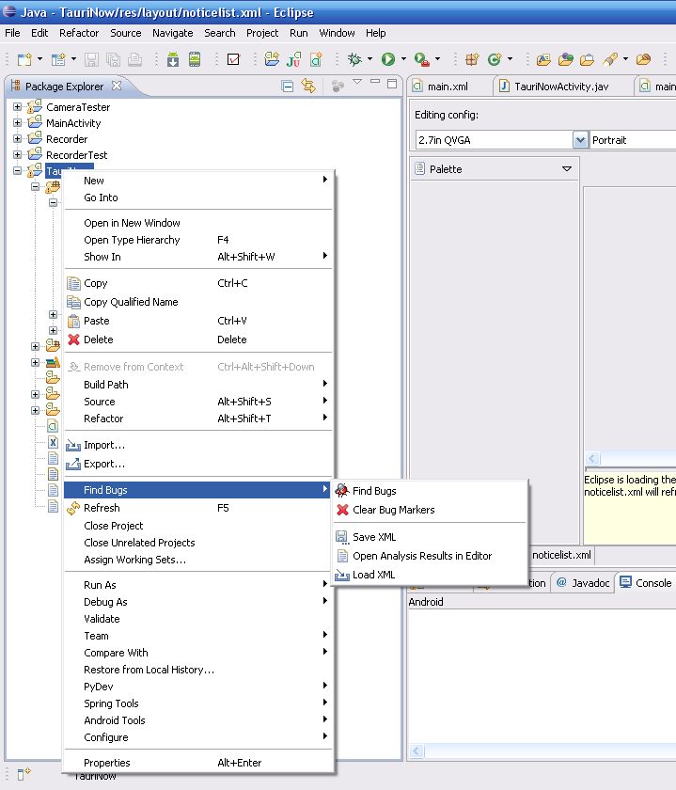
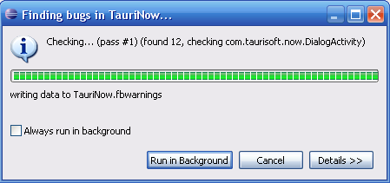
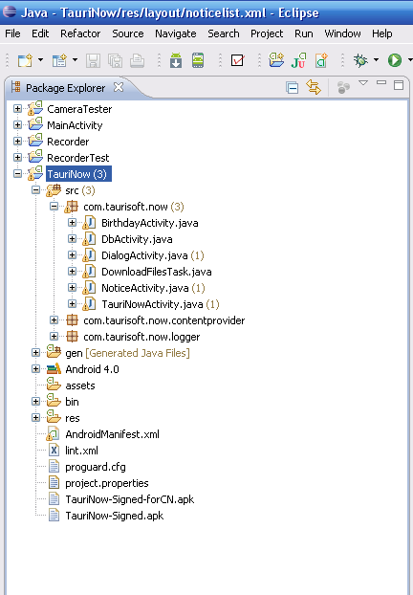
Findbugs

Slide 11
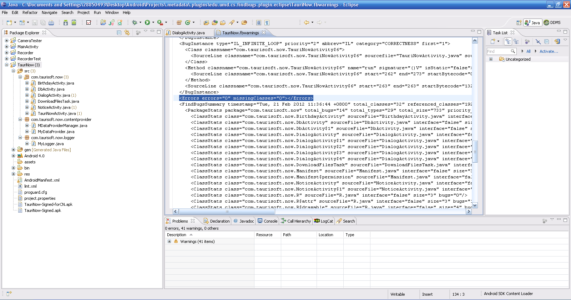
Findbugs - requirement

Slide 12
Monkey
What does Monkey do?
a command-line tool
sends a pseudo-random stream of user events into the system
acts as a stress test on the application
How does Monkey behave in testing?
If you have constrained the Monkey to run in one or more specific packages, it watches for attempts to navigate to any other packages, and blocks them.
If your application crashes or receives any sort of unhandled exception, the Monkey will stop and report the error.
If your application generates an application not responding error, the Monkey will stop and report the error.
Monkey introduction
http://developer.android.com/guide/developing/tools/monkey.html

Slide 13
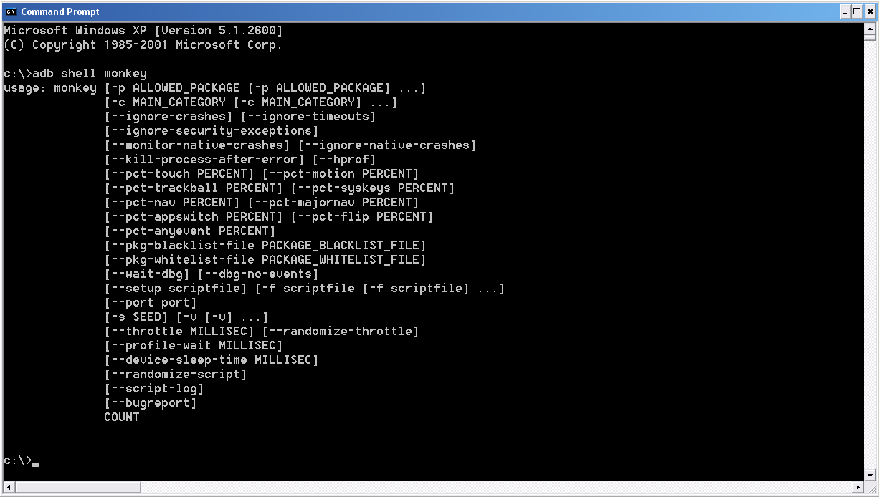
Monkey

Slide 14
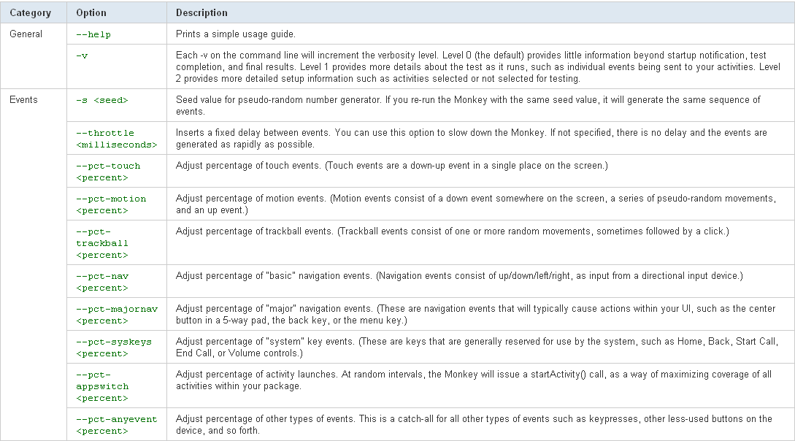
Monkey

Slide 15
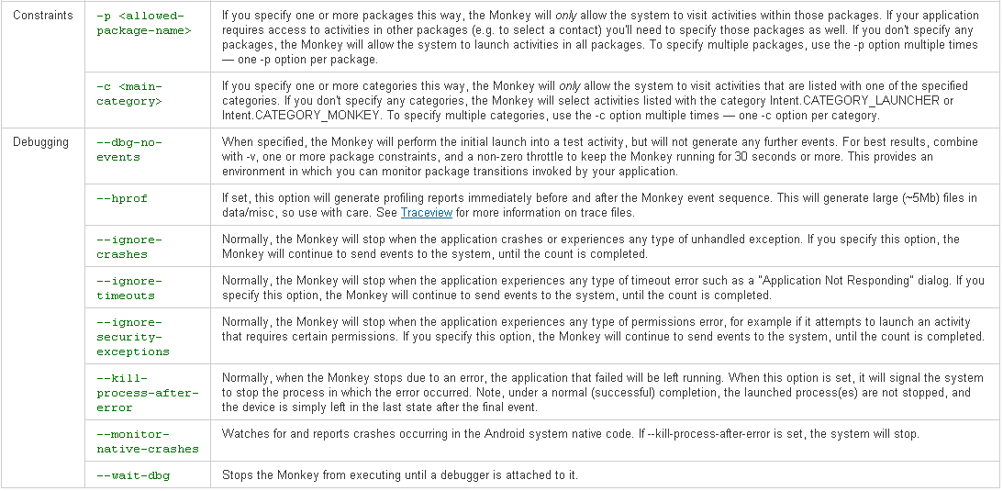
Monkey

Slide 16
Monkey - requirements
adb shell monkey -p de.gavitec.semc --monitor-native-crashes --pct-touch 30 --pct-motion 30 --pct-trackball 0 --pct-nav 0 --pct-majornav 20 --pct-appswitch 10 --pct-anyevent 10 -s 5386 -v --throttle 500 5000
No ANR, App crash, or system crash during monkey testing (with above command).

Slide 17
Other Test Tools
Uiautomator
The uiautomator testing framework lets you test your user interface (UI) efficiently by creating automated functional UI testcases that can be run against your app on one or more devices.
Monkeyrunner
The monkeyrunner tool provides an API for writing programs that control an Android device or emulator from outside of Android code.
With monkeyrunner, you can write a Python program that installs an Android application or test package, runs it, sends keystrokes to it, takes screenshots of its user interface, and stores screenshots on the workstation.
The monkeyrunner tool is primarily designed to test applications and devices at the functional/framework level and for running unit test suites, but you are free to use it for other purposes.

Slide 18
References
ISO/IEC 9126
Software Process Improvement and Capability Determination - ISO/IEC 15504
Software Product Quality: the ISO 25000 Series and CMMI (SEI site)
Software testing
Quality (business): quality control, total quality management.
Software quality model
Software quality assurance
Programming style
Coding conventions
Software architecture
Software metrics
Cyclomatic complexity
Cohesion and Coupling
Standards (software)
Software reusability
Ilities
Accessibility
Availability
Dependability
Testability
Security
Security engineering
bugs
Anomaly in software

Slide 19
Thank you
Q&A

